Slide 1
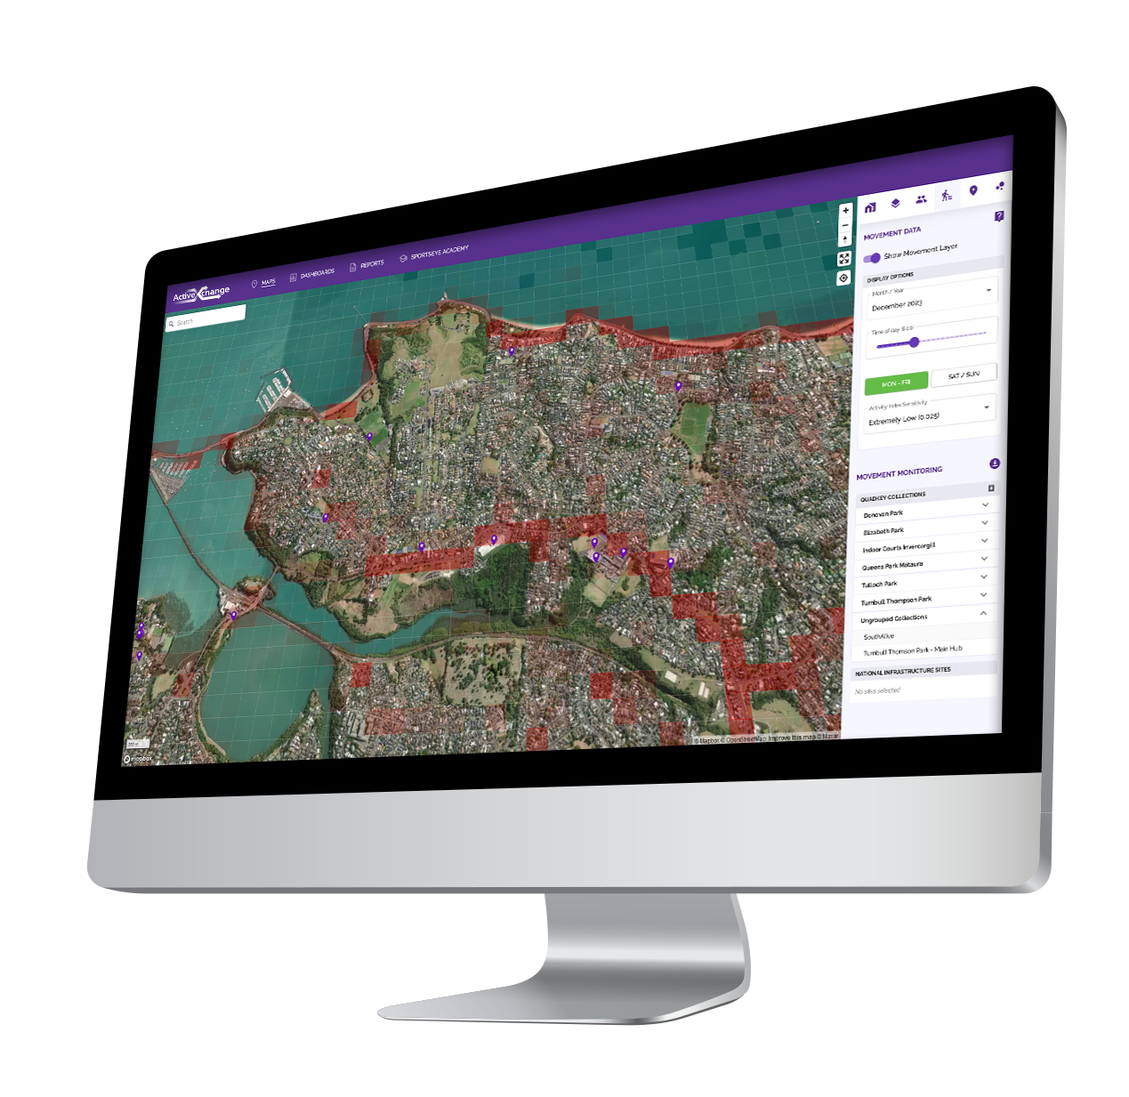
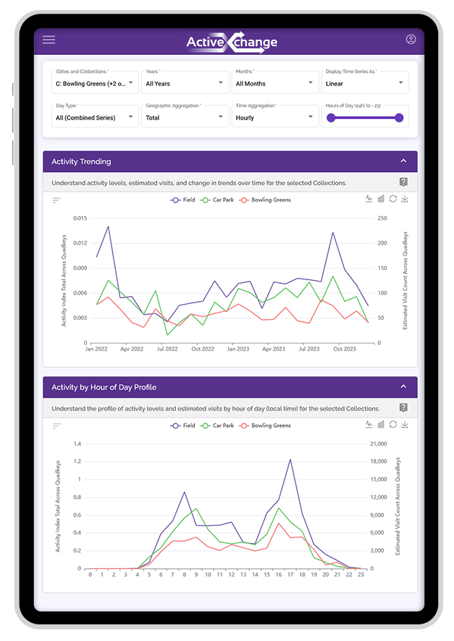
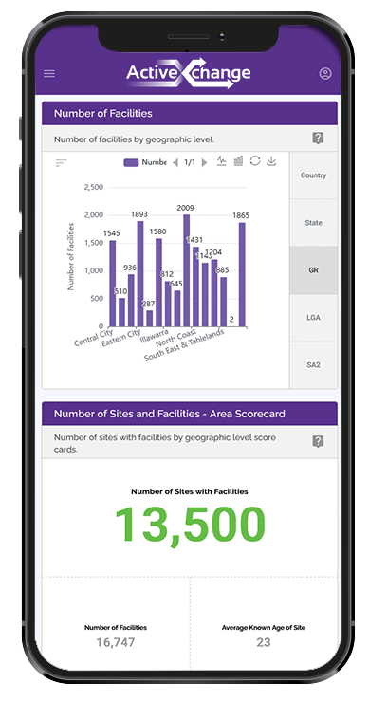
How Inclusive is South Australian Sport?
Notes:
CW to introduce himself

Slide 2
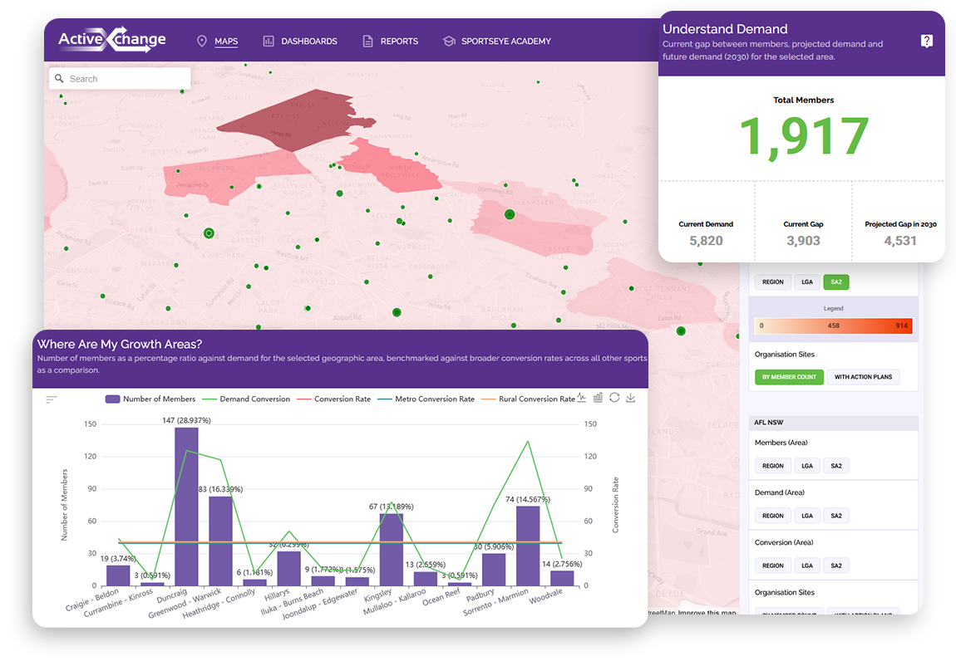
Introducing ActiveXchange
Core Purpose & Modelling

Slide 3
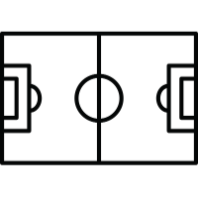
Our ‘why’ is a tireless pursuit of 3 questions
Why is one person more likely to be active than another person?
Why is one location more likely to absorb demand than another?
What is the value of participation to enable evidence-based decisions?
30,000+
Locations
5M+
Leisure, Fitness &
Sport Members
500+
Leisure & Fitness Venues
10,000+
Club Sport Sites
100+
State Sports
150M+
Individual First Party
Data Transactions
11B+
Annual Australian Household Transactions

Slide 4
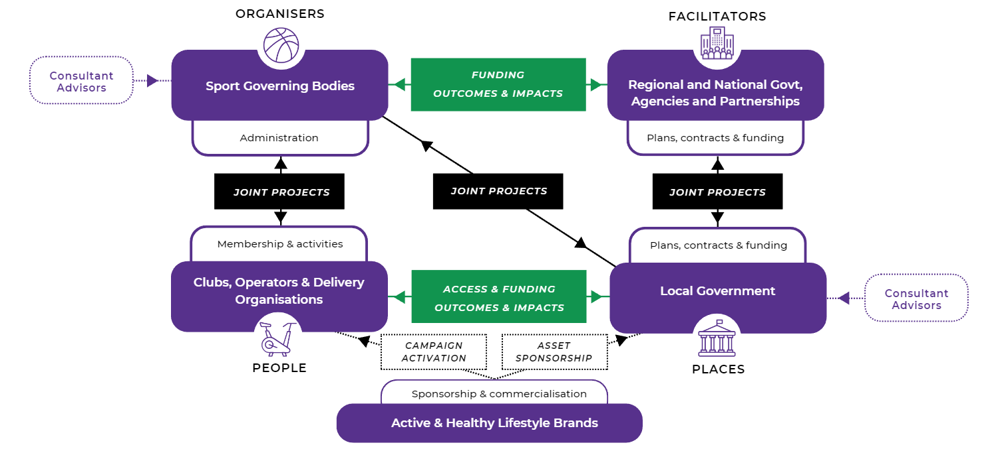
ActiveXchange connects…
An interdependent network
Notes:
Enable by Sport SA
Pulling together Sports from the Governance Reform Project
Connecting them with local governments
Providing insights as evidence to state government and clubs

Slide 5
Early Insights
South Australian Sport

Slide 6
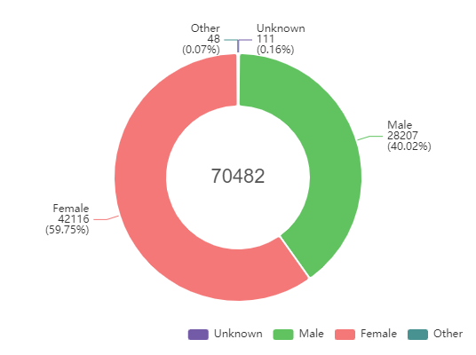
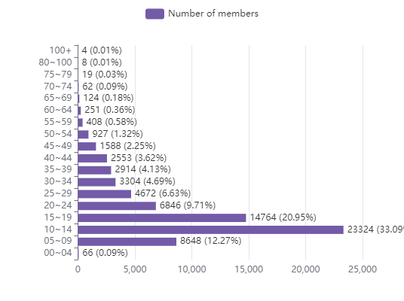
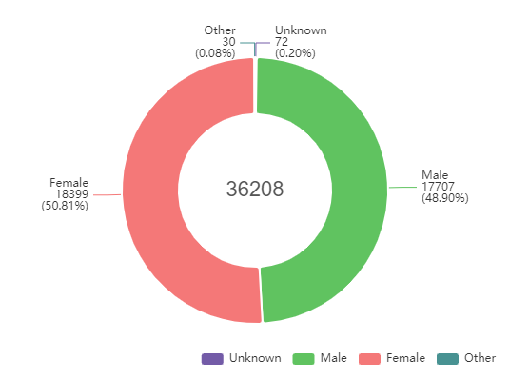
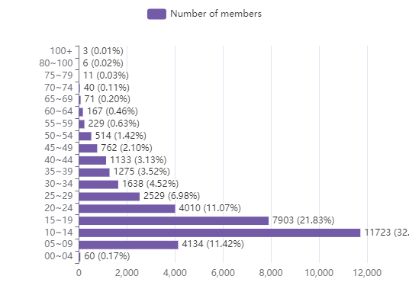
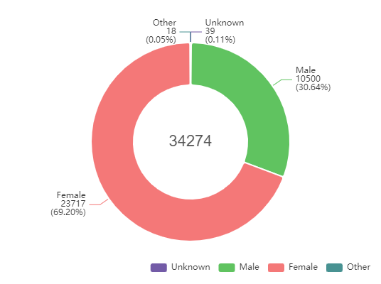
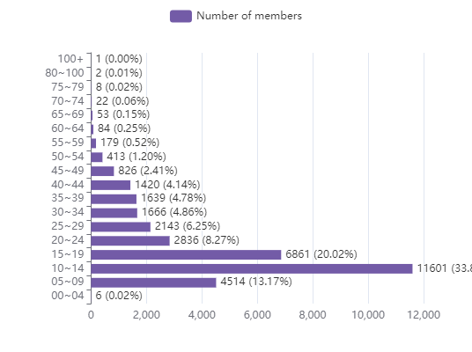
Age and Gender Breakdowns – Sport Members
South Australia
Adelaide Metro
Regional SA
Notes:
CW:
Explain what the data is showing
Mention changes in gender breakwon being seen
Mention that the age profile is typical of other states
Why this looks this way from a sport point of view

Slide 7
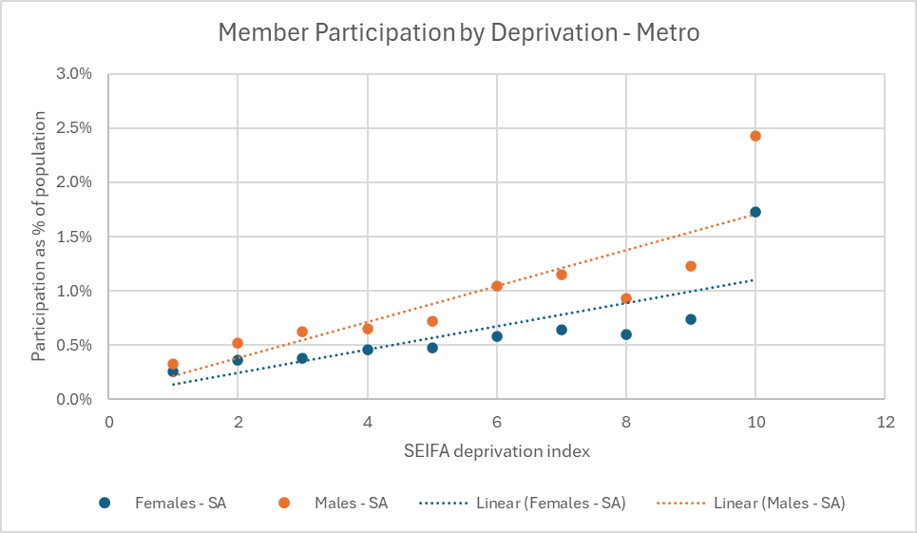
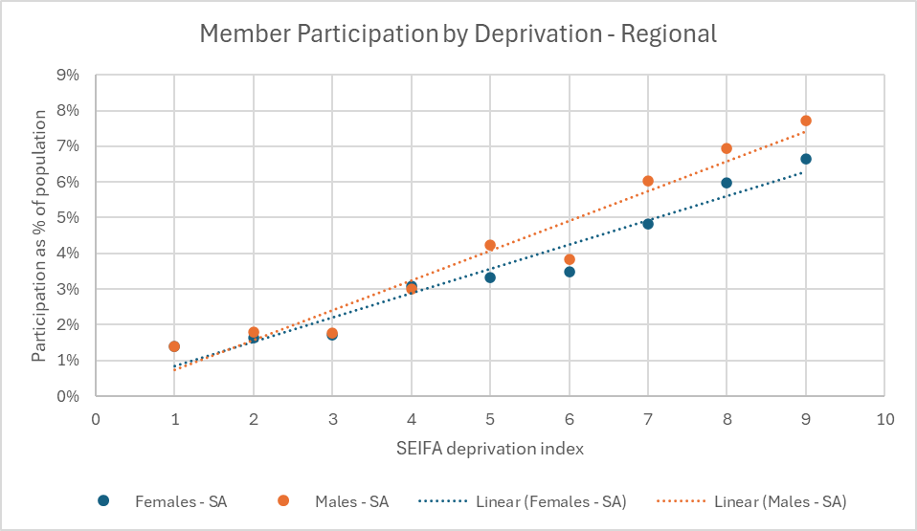
Membership by Deprivation
Notes:
CW
Deprivation is using the SEIFA index - Socio-Economic Indexes for Areas is a product developed by the ABS that ranks areas in Australia according to relative socio-economic advantage and disadvantage.
Explain what the chart is showing
Talk about why this might be

Slide 8
Hotspot Statistical Area 2’s
High Conversion Rate - Adelaide Metro
Munno Para West - Angle Vale
Brighton
Mitcham
Adelaide
McLaren Vale
Marino - Seaview Downs
High Conversion Rate - Regional SA
Mount Barker
Aldgate - Stirling
Kangaroo Island
Loxton
Port Augusta
Roxby Downs
Low Conversion Rate - Adelaide Metro
North Haven
Enfield - Blair Athol
Paradise - Newton
Pooraka - Cavan
Salisbury
Ingle Farm
Low Conversion Rate - Regional SA
APY Lands
Coober Pedy
Outback
Mannum
Peterborough - Mount Remarkable
Quorn - Lake Gilles
Notes:
CW:
SA2’s are statistical areas set by the ABS which refer to the suburb
Conversion Rate is using our Demand models to identify estimated Demand for the area and the conversion rate is the percentage of that demand that are currently sports members so it’s essentially a more detailed measure of participation rate
High conversion rate
Throw to crowd, what looks out of place here
Munno Para: majority of demand absorbed by netball association in Elizabeth
Other lists: pick out and mention individual charateristics

Slide 9
What do these Populations Look Like?
South Australia Total Population
Indigenous: 2.71%
Language Other Than English: 13.61%
Needs for Assistance (includes Disability): 19.8%
High Conversion Rate - Adelaide Metro
Indigenous: 0.98%
Language Other Than English: 14.41%
Needs for Assistance: 17.4%
High Conversion Rate - Regional SA
Indigenous: 4.71%
Language Other Than English: 5.00%
Needs for Assistance: 18.6%
Low Conversion Rate - Adelaide Metro
Indigenous: 2.09%
Language Other Than English: 30.18%
Needs for Assistance: 22.1%
Low Conversion Rate - Regional SA
Indigenous: 22.80%
Language Other Than English: 19.78%
Notes:
CW
Explain limitations in census data for
Needs for Assistance
Indigenous regional
Explain why it’s historically hard for sports to engage these communities

Slide 10
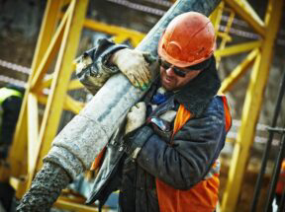
Most Common Household Segments
High Conversion Rate - Adelaide Metro
High Conversion Rate - Regional SA
Scenic Connection: Older couples in semi-retirement, living in suburban areas and nearby towns for many years, with high income
Country Town Courage: Monocultural, manual workers living in rural towns
Low Conversion Rate - Adelaide Metro
Low Conversion Rate - Regional SA
Realistic Horizons: Gen X couples and sharers living in outer-suburban and regional areas, with low income and small properties
Rustic Isolation: Traditional, singles in far inland remote towns
Life in the Slow Lane: Middle-aged, blue-collar couples living in outer-suburban/metro-fringe areas, with average income
Notes:
CW
Explain what these are
Link to barriers/enablers for participation
Pick some highlights from what we see

Slide 11
www.activexchange.org
callum@activexchange.org

Slide 12
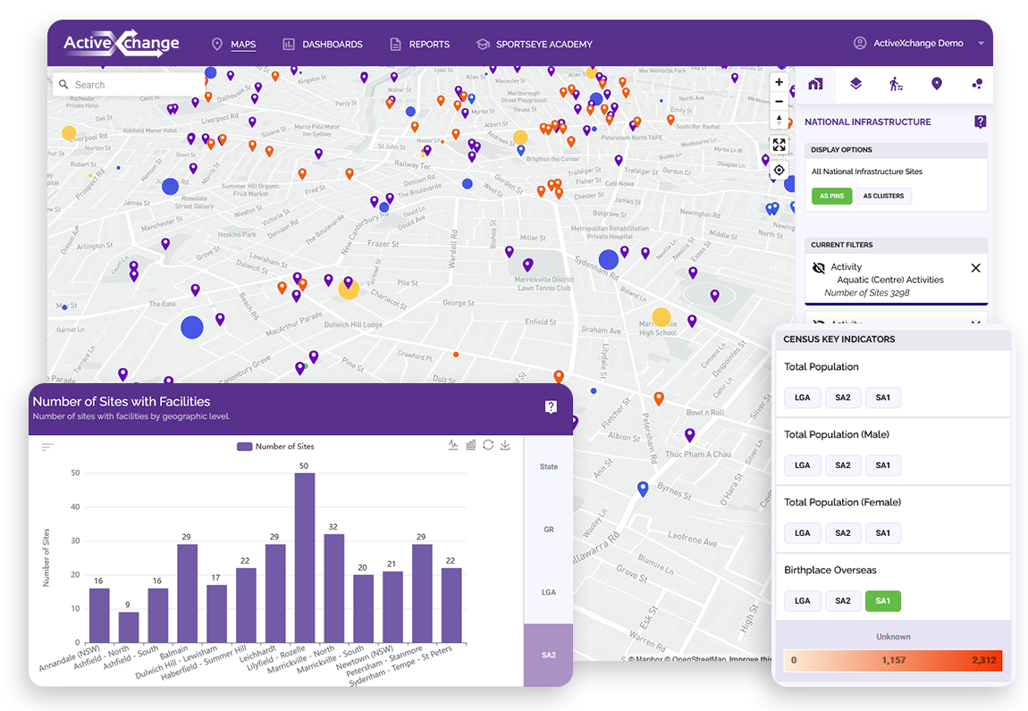
National Infrastructure Database

Slide 13
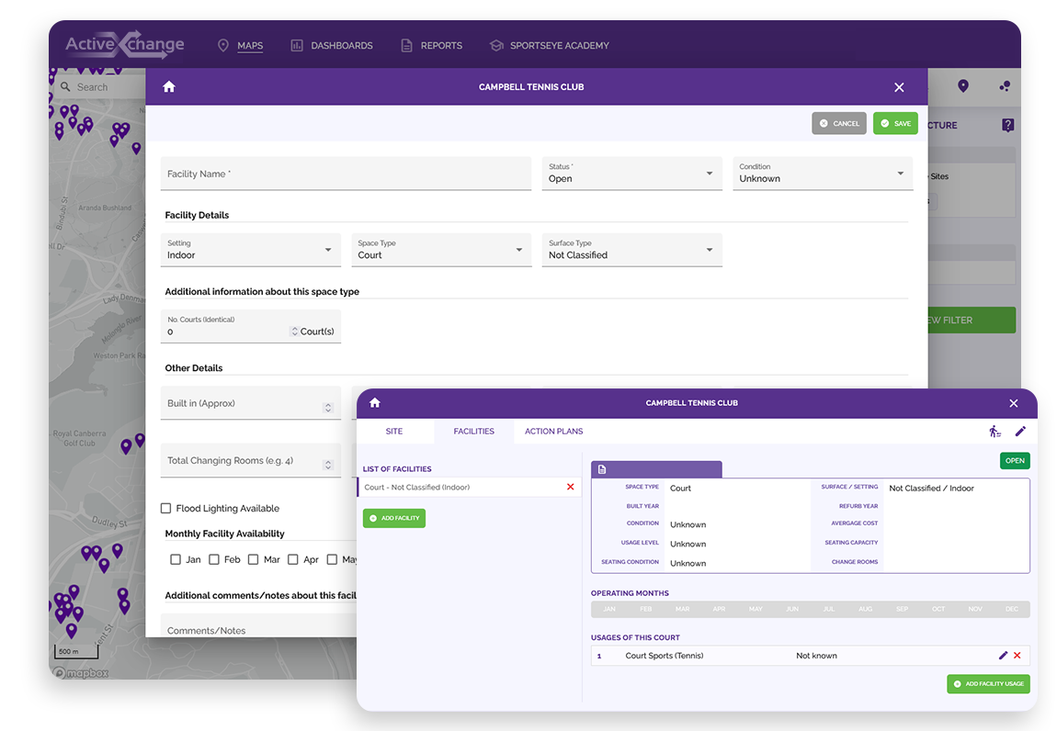
National Infrastructure Database
Starting your data journey
Free access
Features 30,000+ sport, leisure, aquatic, fitness and recreation sites
Provides all stakeholders with a common and open data repository for adding, managing and accessing relevant non-commercially sensitive infrastructure information
Saves time and cost on duplication efforts throughout the sector
Provides access to localised demographic and community profile data, all delivered through an interactive mapping tool
Dashboard gives users a deeper understanding of how infrastructure levels in each geographic area align with the total population, and how this compares with neighbouring councils

Slide 14
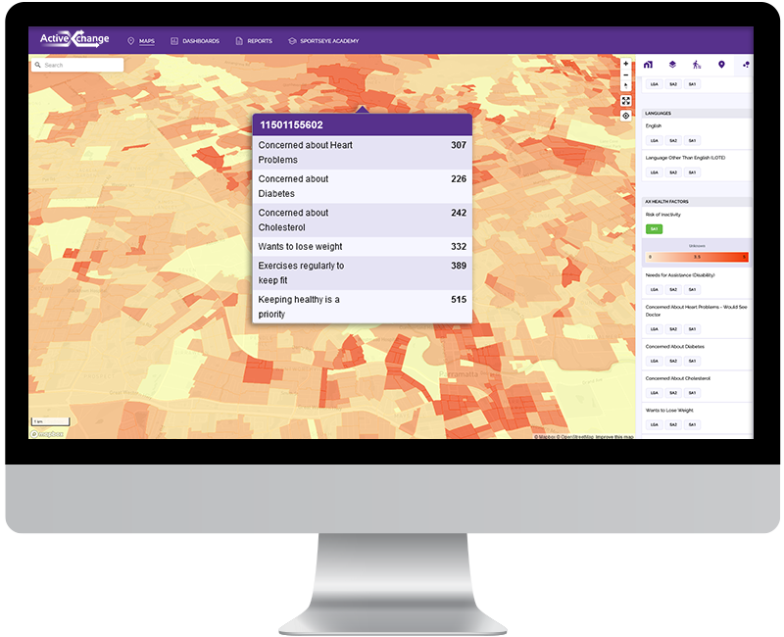
National Infrastructure Database
Data integrity
ActiveXchange’s Data Science Team sourced initial data through their own research and web scraping
Supported by state governments, sport associations, national bodies and the largest consultancies, who all assisted in the initial data sourcing and ingestion
With every new customer and partner added into the network, we add and update sites, facilities and usages data to ensure currency and non-duplication
ActiveXchange’s quality control processes ensure maximum data integrity for every new data ingestion
Open source platform, which means anyone can add, edit and manage sites & facilities data - however all users must be approved by ActiveXchange before gaining access

Slide 15
National Infrastructure Database
Data schema
Sites
Action Plans
Facilities
Usages

